Slide 1
xv6 memory, schedule improvement agent
Team OS_JPLKJ
2022270638_조현성
2022270654_박규태
2021270603_이찬주
2022270656_김경선
2022270620_조승찬

Slide 2
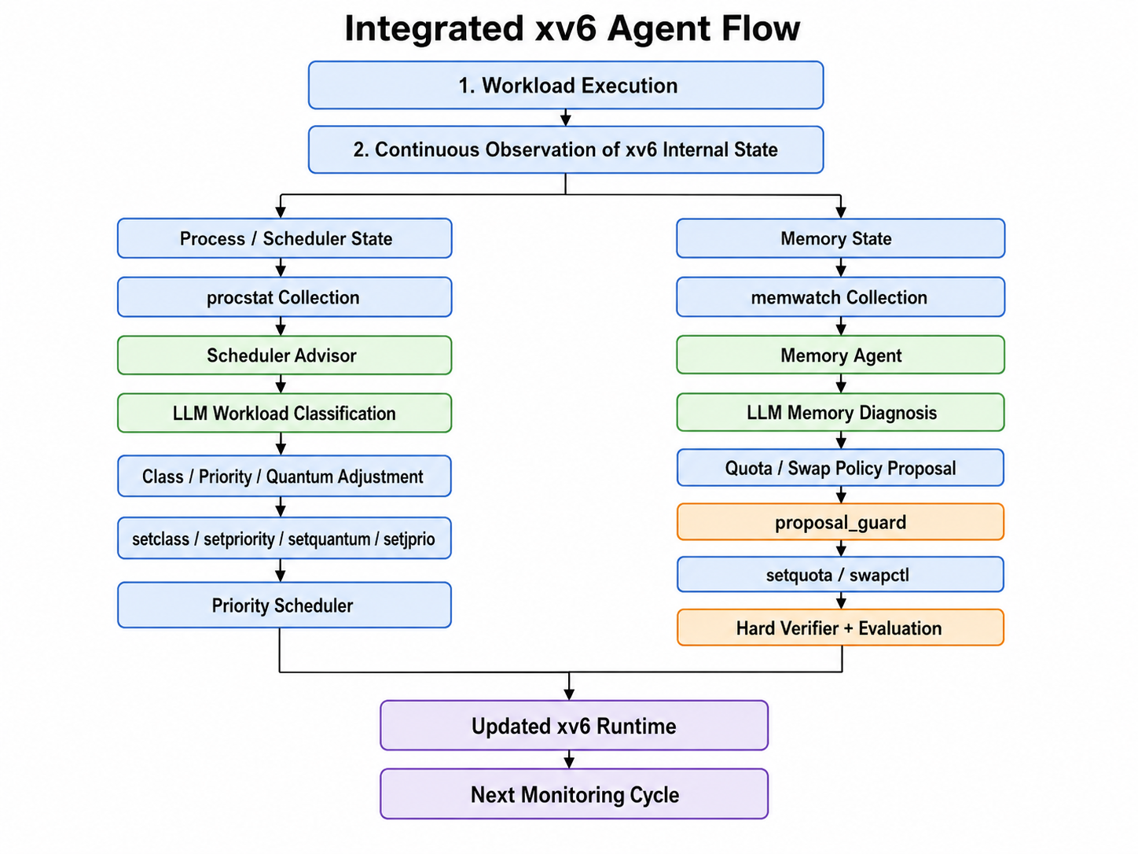
Integrated Core Agent Logic Flow

Slide 3
Core Agent Logic Flow/memory
1. Observe + Bridge detection
Next monitoring cycle
2. LLM analysis + one concrete candidate
(action / target / value)
Reject before apply
No rollback needed
3. proposal_guard pre-check
No
Safety
passed?
Yes
4. Approve → apply in xv6 runtime
Record failure tag
feed it into the next prompt
5. Hard Verifier post-check
Safety
passed?
Quota evaluation
No
Yes
• perf: fewer denials
• stab: less thrashing
• eff: headroom
6. Policy-specific evaluation
quota: weighted score / swap: stability
Rollback
restore previous state
Swap evaluation
Criteria satisfied?
No
• Hard Verifier PASS
• stab ≥ threshold
• no excess cycles
Yes
8. Keep policy + return to monitoring
Key point: the LLM proposes; guard, verifier, and metrics decide whether to keep it.

Slide 4
Core Policy Modules: Quota and Swap
The LLM selects the policy and proposes the concrete value to apply.
LLM analysis + policy selection + target/value proposal
Quota
Swap
What the LLM decides
What the LLM decides
• Should quota be used?
• Which process is the target?
• Increase, decrease, keep, or release?
• What final quota in bytes?
• Should swapout be used?
• Which process is the target?
• How many pages should be swapped out?
• Kernel swap logic selects the actual victim pages.
Runtime command
setquota <pid> <bytes>
Runtime command
swapctl <pid> <pages>
Each separates the policy into a modular form and effectively reduces meaningless loops in the form of llm proposing fine-tuning.

Slide 5
Dual Safety Checks: Before and After Runtime Apply
Two different checks reduce unsafe loops and catch different failure modes.
LLM candidate
proposal_guard
pre-check
runtime apply
setquota / swapctl
Hard Verifier
post-check
proposal_guard blocks unsafe candidates
Hard Verifier checks runtime stability
• allowed action only
• target PID exists
• protect init and sh
• quota floor: sz + 4096
• conservative swapout page count
• manual approval before mutation
• no panic / kerneltrap
• init and sh remain alive
• target process remains alive
• memwatch still works
• no pattern mismatch
• swap slot bounds are valid
• swapout activity is observed
Guard "blocks dangerous proposals" and Verifier "check kernel stability after application"

Slide 6
Evaluation and Rollback: Quota Uses Score, Swap Uses Stability
The LLM does not score policies; Python code evaluates fixed metrics.
baseline state
apply candidate
candidate state
evaluate
Quota score
Swap stability
perf
w1
→ weighted score comparison
×
stab ≥ 0.85
stab
×
w2
no excessive swap cycles
eff
×
w3
Quota metrics
Current scope
• perf: fewer quota denials
• stab: lower thrashing ratio
• eff: useful headroom, not waste
• focuses on preventing instability
• does not yet measure full swap benefit
• future metrics: free pages, OOM avoidance, I/O cost
Each calculation and standard are set aside to increase reliability

Slide 7
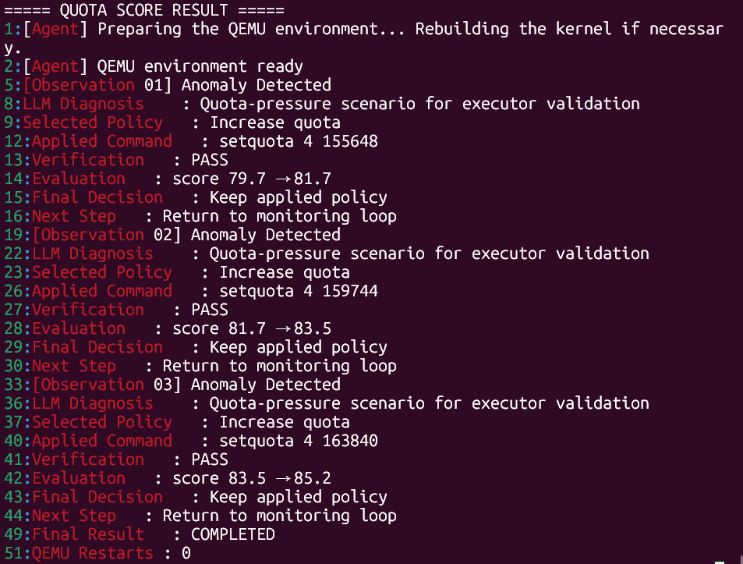
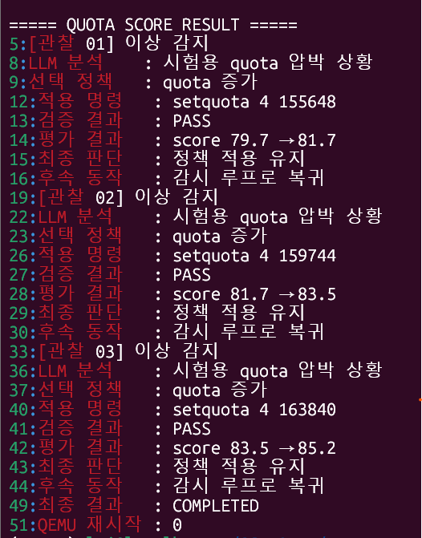
Results/quota
eng
kor

Slide 8
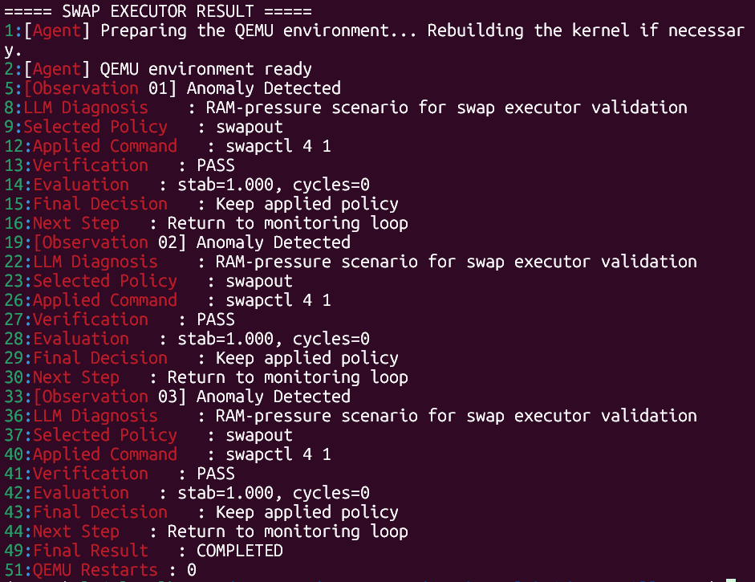
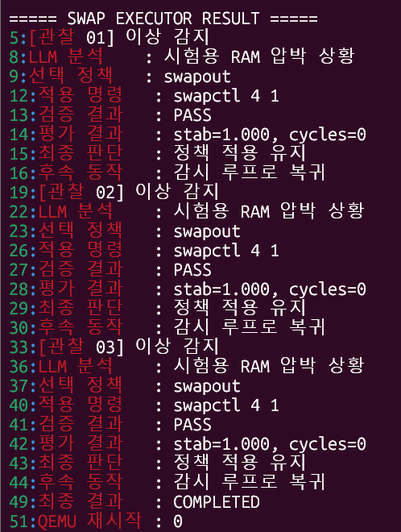
Results/swap
eng
kor

Slide 9
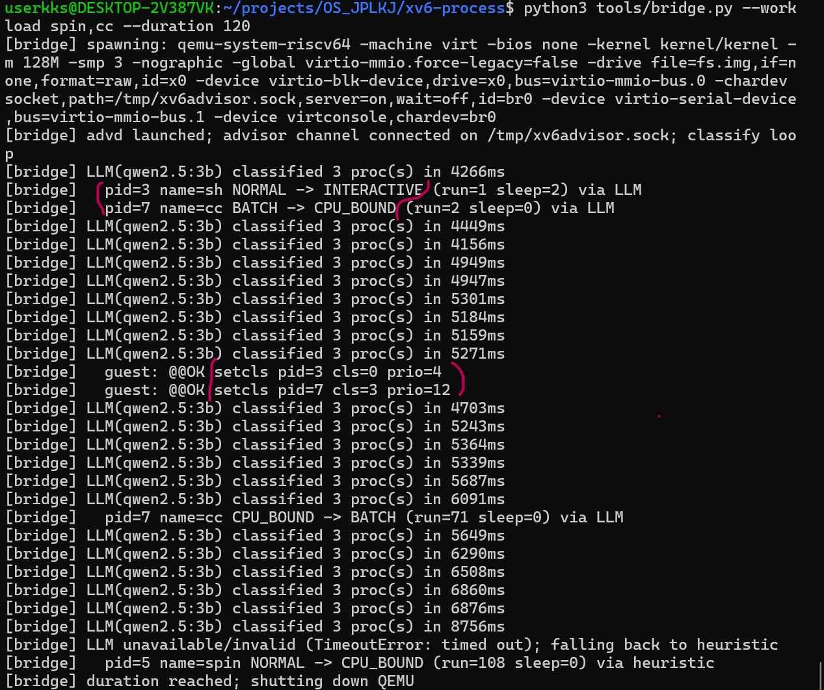
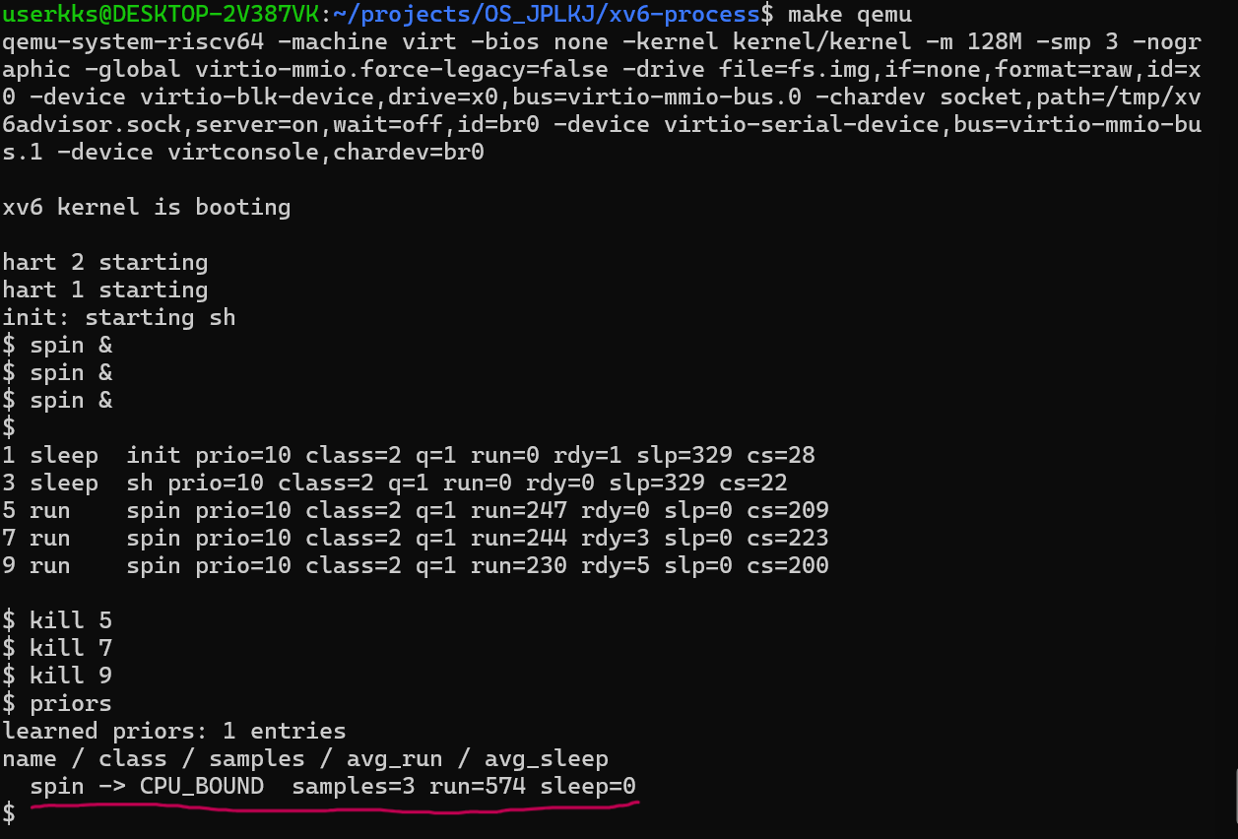

LLM Scheduler Demonstration
Immediate name-based classification with automatic
priority and quantum adjustment
2. Pattern-based learning accumulated
by process name after termination

Slide 10
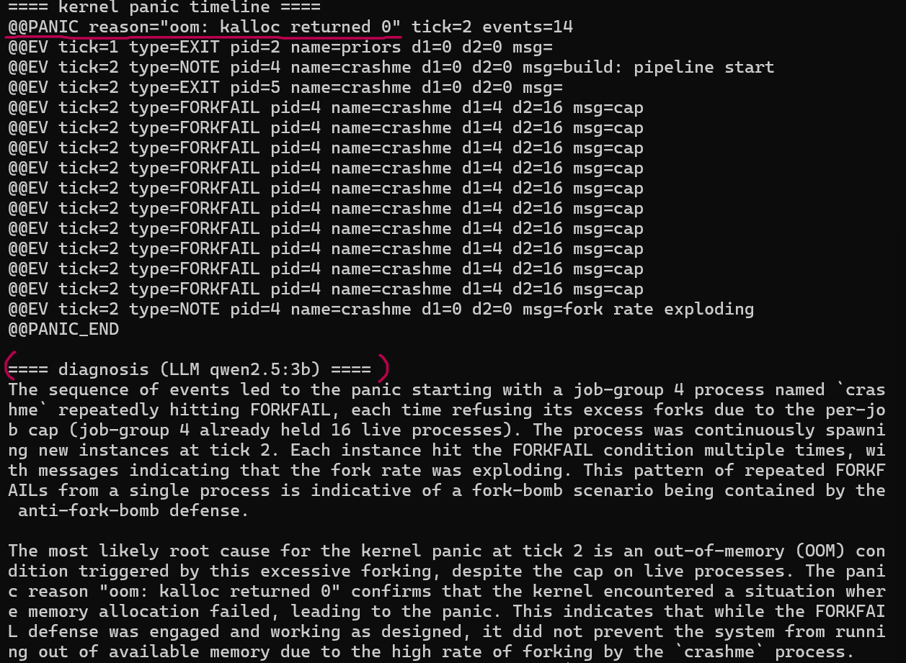
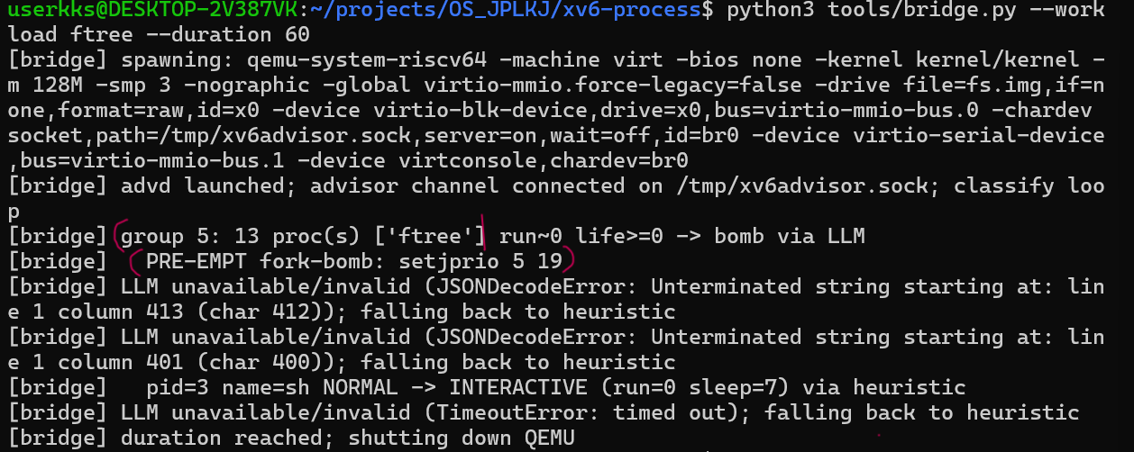


4. Kernel panic timeline analysis with
LLM-based natural language diagnosis
3. Job-group management with fork-bomb detection
and mitigation

